Slide 1
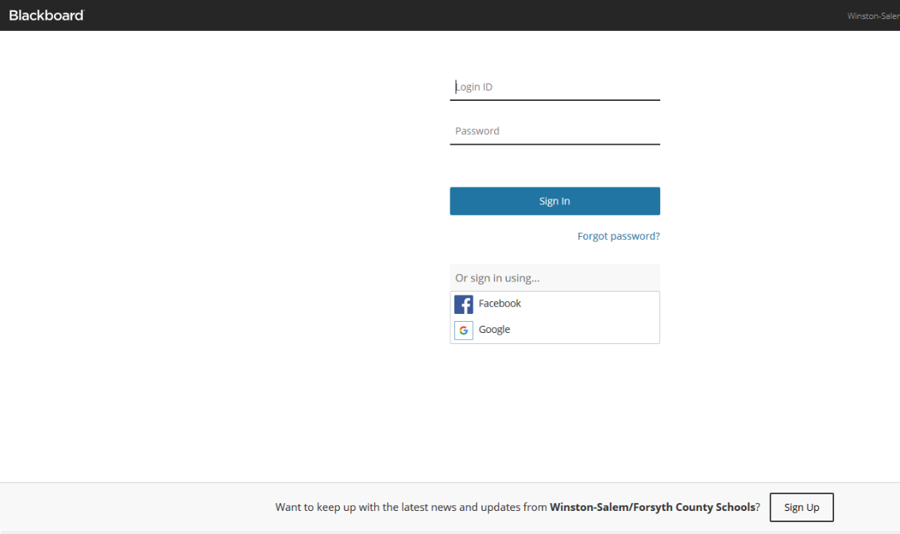
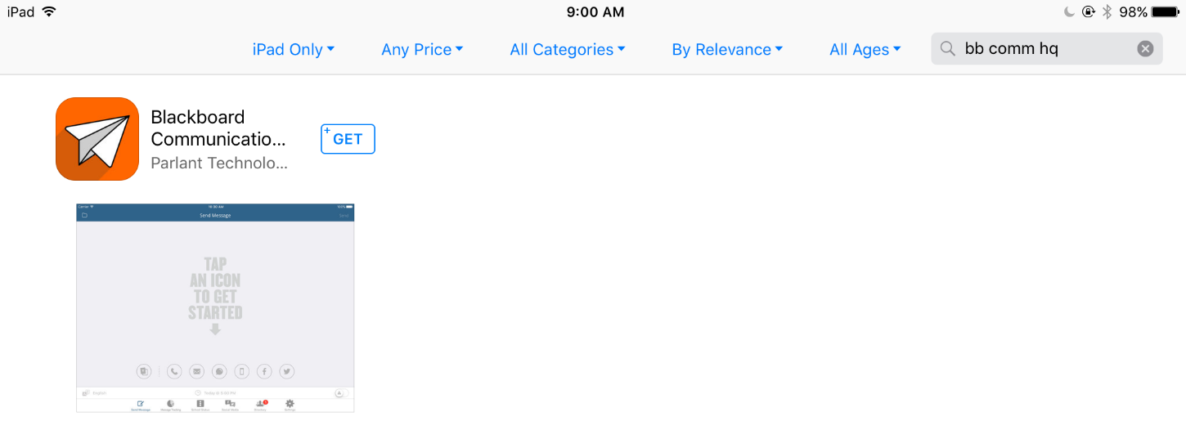
Mass Notification (Parentlink / Connect 5i)
Login to the System
There are 2 ways to access the Mass Notification (aka Parentlink / Connect 5i) system:
1) PC URL - https://clevelandmetro.parentlink.net
2) Mobile App = BB Comm HQ
Go to iTunes or Google play stores
Search for “BB Comm HQ” and download it
your device
Once downloaded, you will see the App icon
Key Points:
The Username/Password is the same for both
The Message Send interface is very similar for both
Any Password changes will be reflected across both
NOTE: If you change the Password, it should not take longer than 30 minutes
for the Password change to be reflected across both

Slide 2
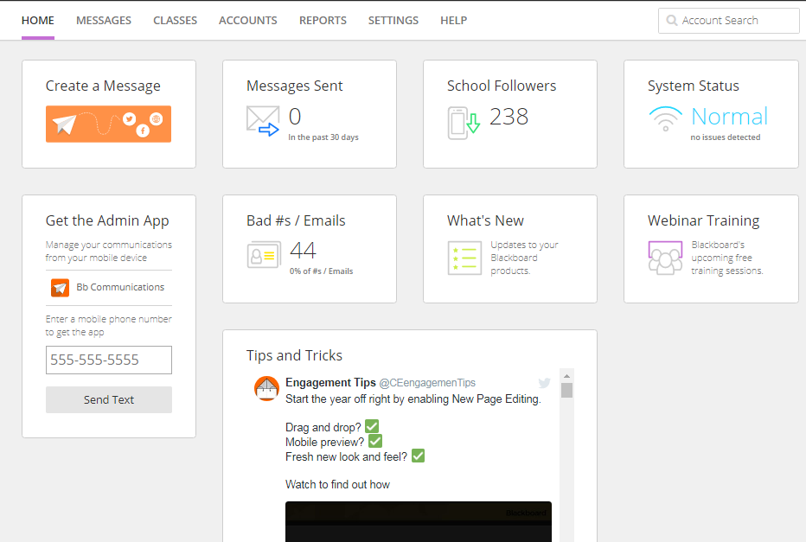
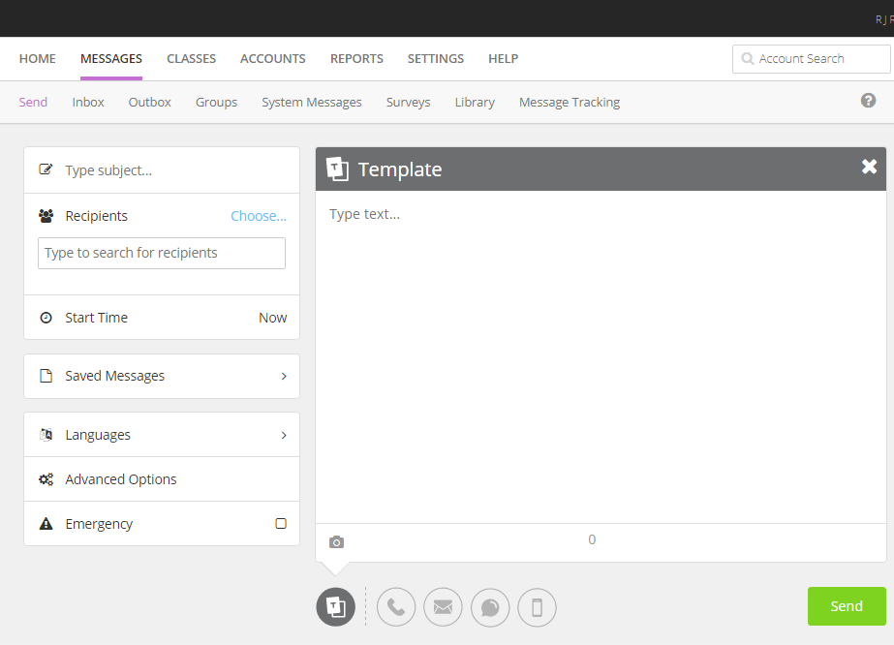
Mass Notification (Parentlink / Connect 5i)
Message Send
Sending a message video
To Send a message, click on the “Create a
Message” tile
1
2
3
4
5
Key Points:
Type subject: What is the Subject ?
Recipients: Who are the recipients ?
Start Time: What time do you want the message to be sent ?
Languages: Provides the option to send translate messages into
different language (as provided by PowerSchool)
Advance Options: Allows you to schedule the message in the future OR send it multiple times
Emergency: Prioritizes the message at the top of the send list

Slide 3
Mass Notification (Parentlink / Connect 5i)
Selecting Recipients – 2 ways
Type in “Parents” & a pop-up will be displayed
OR you can type “Students”
1
If you wanted to select a “subset of Parents” OR
a “subset of Students”, click on Groups

Slide 4
Mass Notification (Parentlink / Connect 5i)
Message Send
Click on “Choose”
You can expand/collaps each selection to
select the recipients

Slide 5
Mass Notification (Parentlink / Connect 5i)
Start Time
The system defaults the Sart Date/Tim 15 min into the
BUT you can change it AND schedule the same message
To be sent at a future date (reminders)
Once you have typed your message and selected
the modalities (ie Phone, Email, Sms/Text, App),
Press Send

